Slide 1
AZURE VIRTUAL MACHINE
ARCHITECTURAL REVIEW
PREPARED FOR
Irfan’s-DemoTest
May 2023

Slide 2

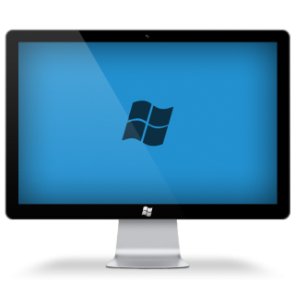



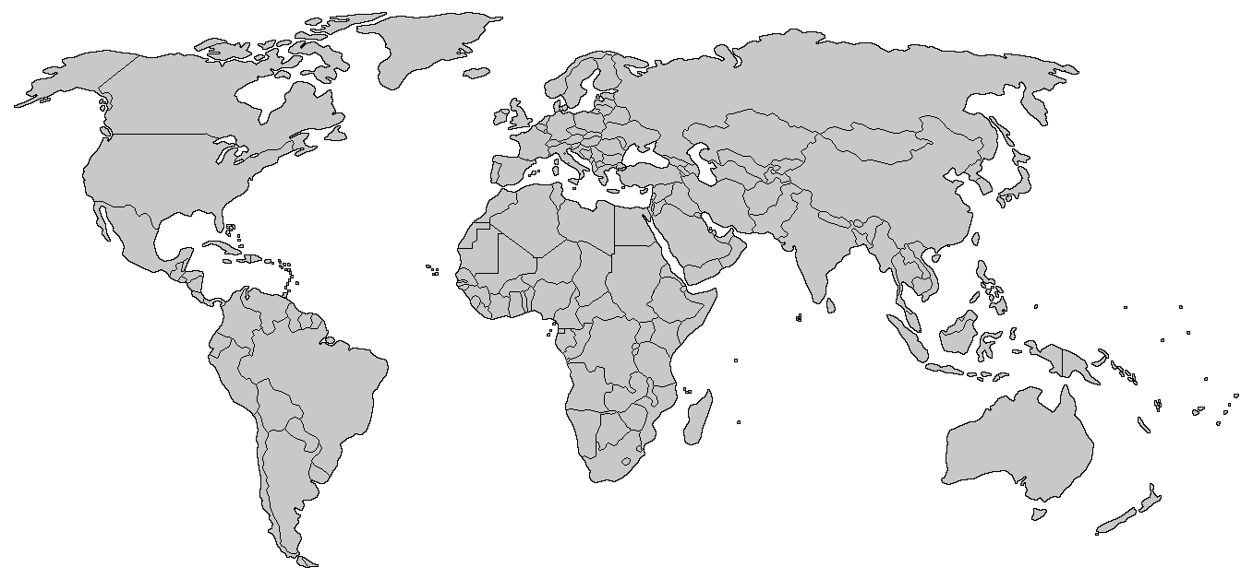



Current Scenario
VPN Connect
Connected
Deploys Code
Conditional Access to Private IP VM
Cisco VPN
Workstation on Private IP
Azure DevOps
Developer
Network
Latency
USA
INDIA

Slide 3
Solution-01
SOLUTION
To have a Azure hosted VM with MFA authentication enabled to the users.
Solution-02
Creating Azure VM with Cisco VPN installed in it.
Using Bastion Service.
Using Azure Virtual Network Gateway.
Solution-03

Slide 4
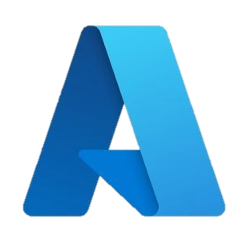
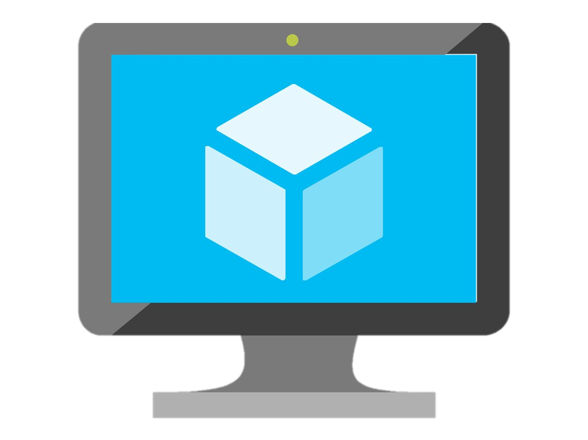
Solution-01: Azure VM with Cisco
Conditional Access to Private IP
RDP
Connected
Deploys Code
Public Ip Vm
Cisco VPN
Azure DevOps
Developer
Laptop
Workstation on Private IP

Slide 5


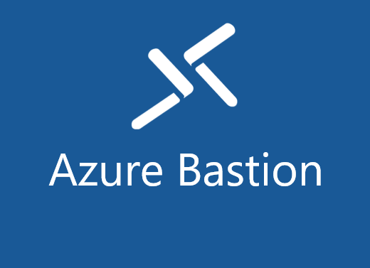
Solution-02: Bastion Service
Azure Bastion is a fully managed service that provides more secure and seamless Remote Desktop Protocol (RDP) and Secure Shell Protocol (SSH) access to virtual machines (VMs) without any exposure through public IP addresses.
MFA
AzureBastionSubnet
Conditional Access to Private IP
Virtual Network
SSL 443
Deploys code
Azure Portal
Bastion Service
Azure Vm on Private Ip
Azure DevOps
Developer
Laptop

Slide 6
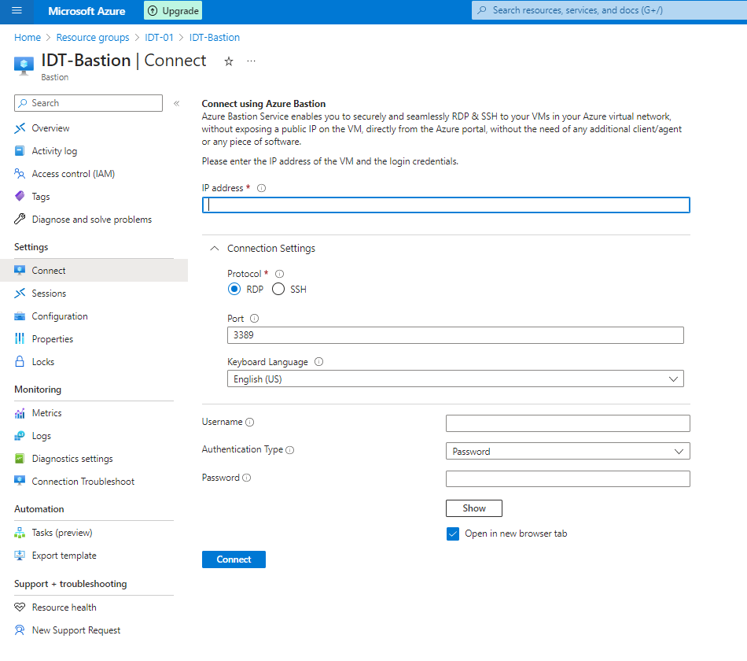
Solution-02
Enter your Vm private IP
Enter your Vm credentials.

Slide 7
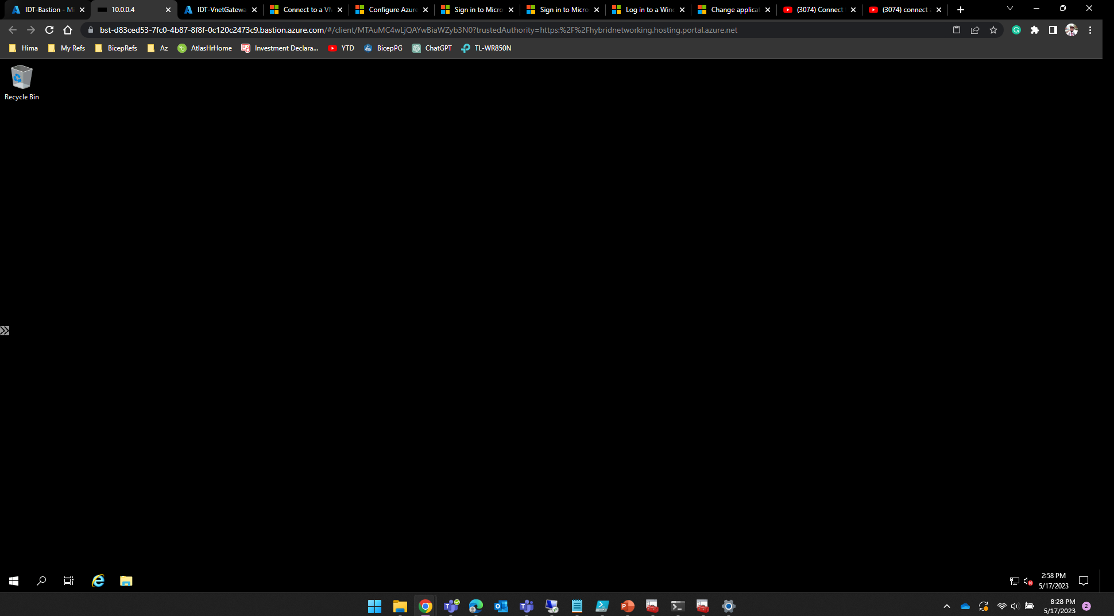
Solution-02
This is how it opens VM using SSL 443 port in our current browser.

Slide 8
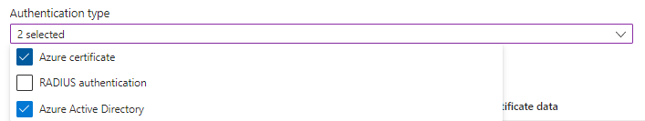

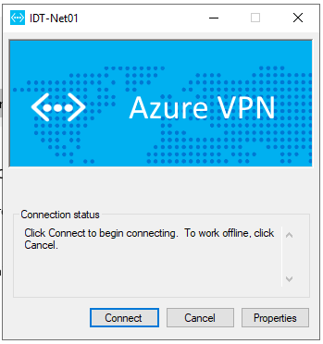

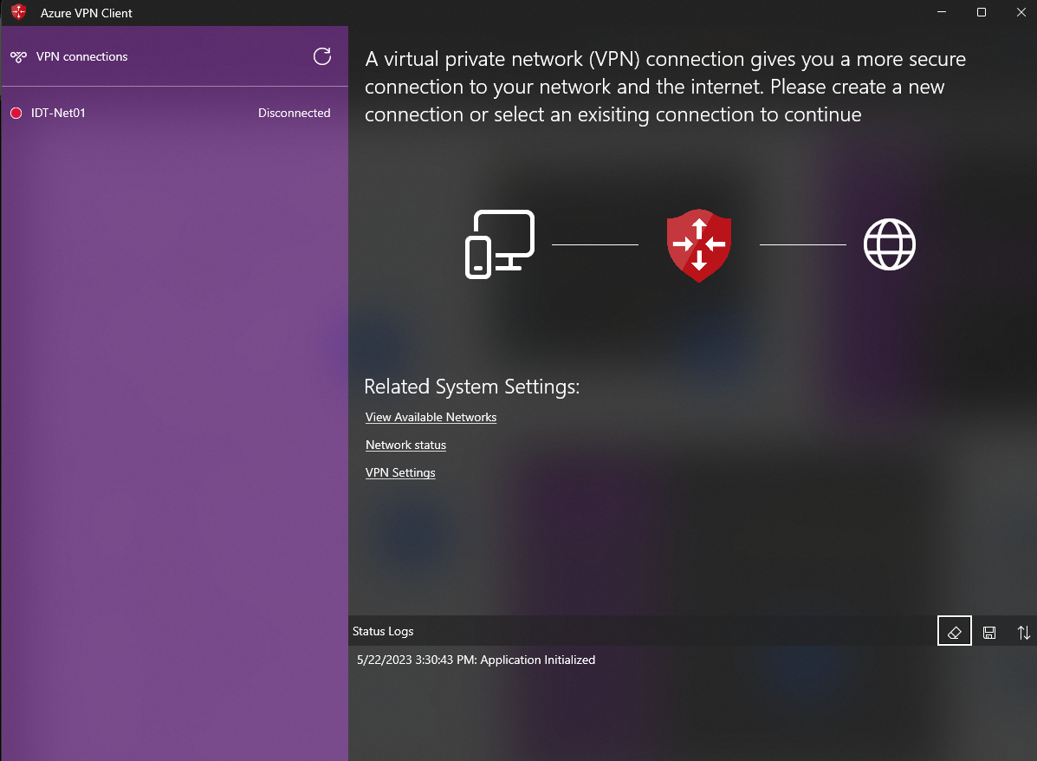
Solution-03: Virtual Network Gateway
A Point-to-Site (P2S) VPN connection helps to create a secure connection tunnel to your virtual network (VNet) from an individual client computer device. P2S VPN is established by initiating it from the client’s computer device.
Az Certificate
Root & Child Certificates
Virtual Network
Virtual Network Gateway
Authentication -01
Azure Certificates
Developer
Laptop
Conditional Access to Private IP
MFA
Azure VM on Private IP
Azure DevOps
Azure VPN
Authentication -02
Azure Active Directory

Slide 9
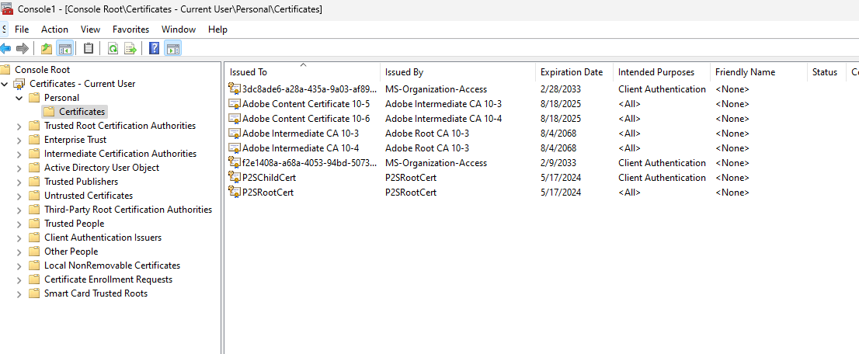
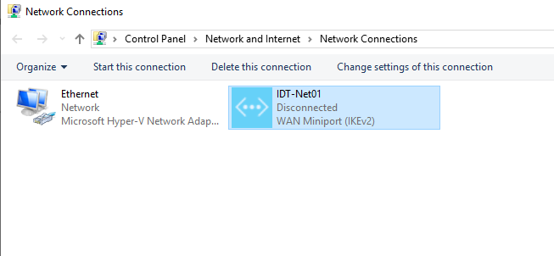
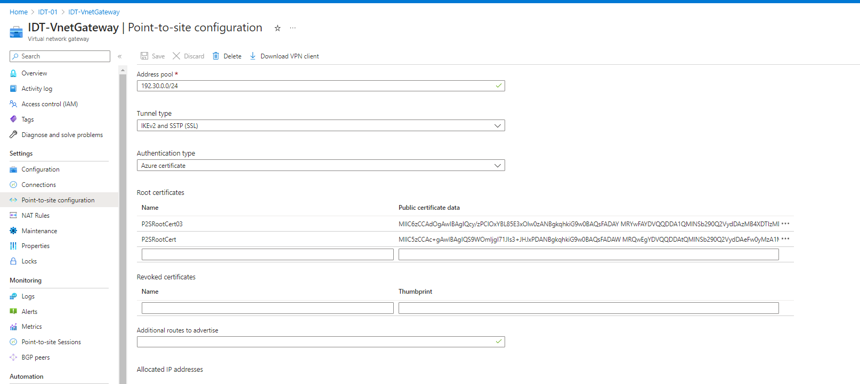
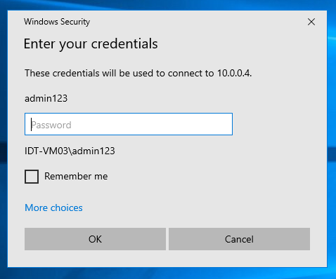
Azure Certificate
01
03
02
05
04

Slide 10
Solution-03: Virtual Network Gateway
Az Certificate
Root & Child Certificates
Virtual Network
Virtual Network Gateway
Authentication -01
Azure Certificates
Developer
Laptop
Conditional Access to Private IP
MFA
Azure VM on Private IP
Azure DevOps
Azure VPN
Authentication -02
Azure Active Directory

Slide 11
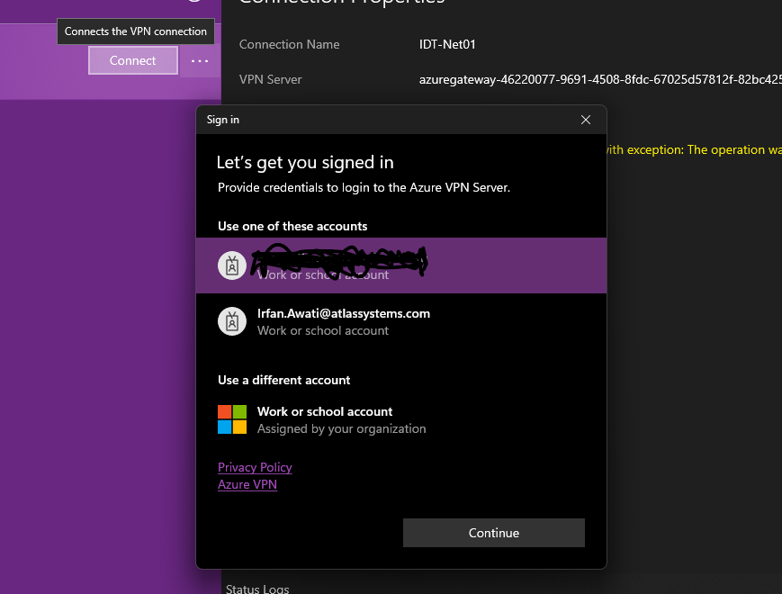
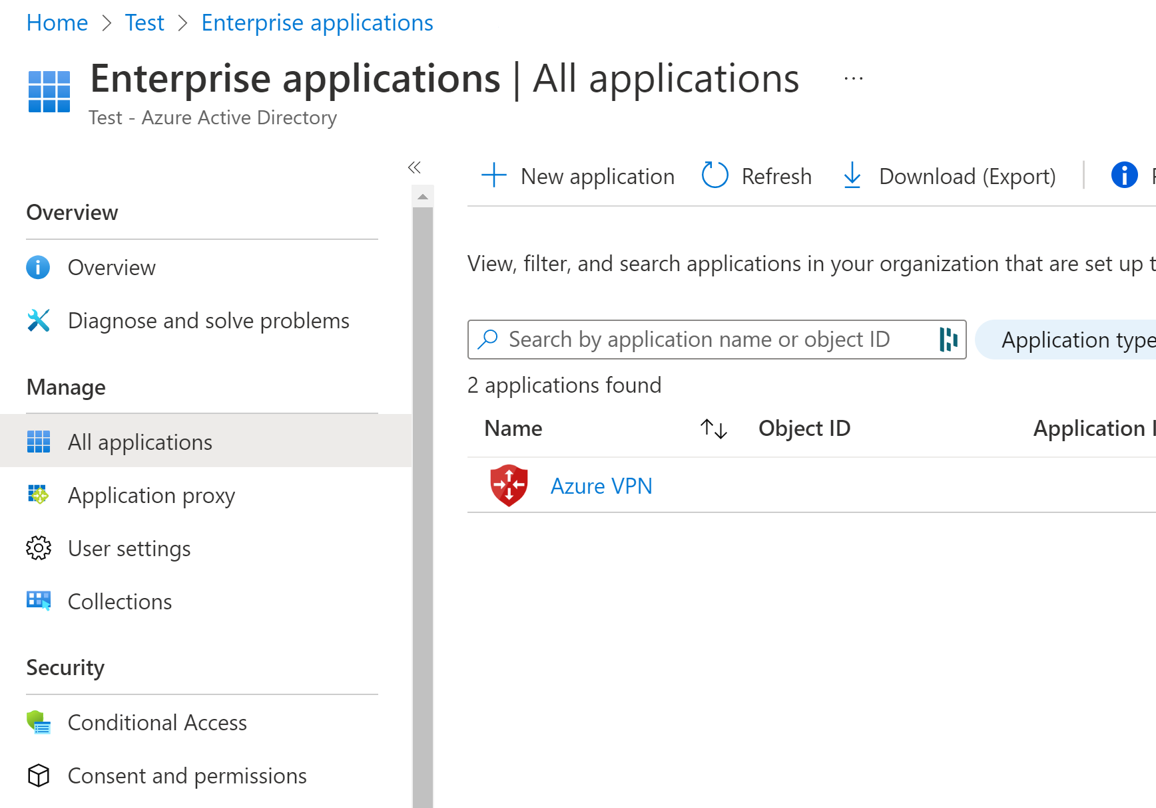
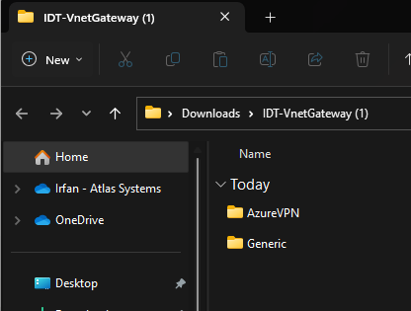
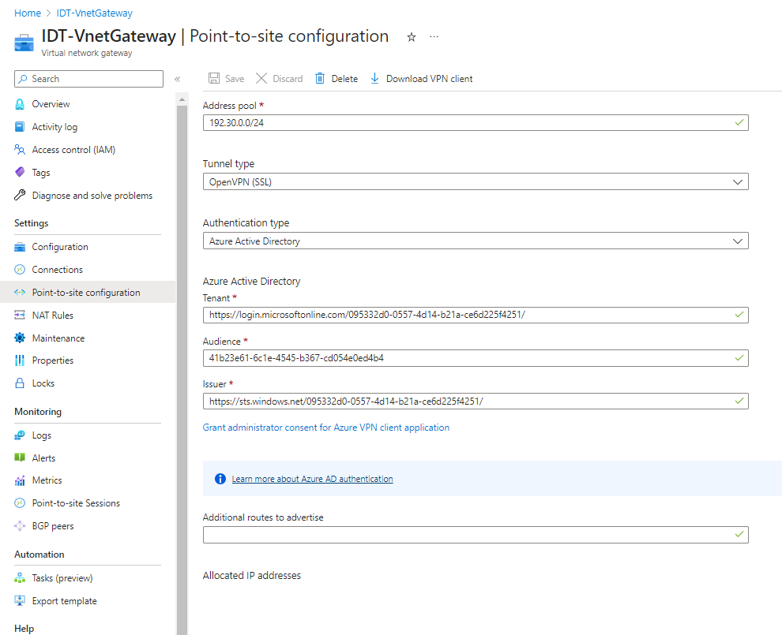
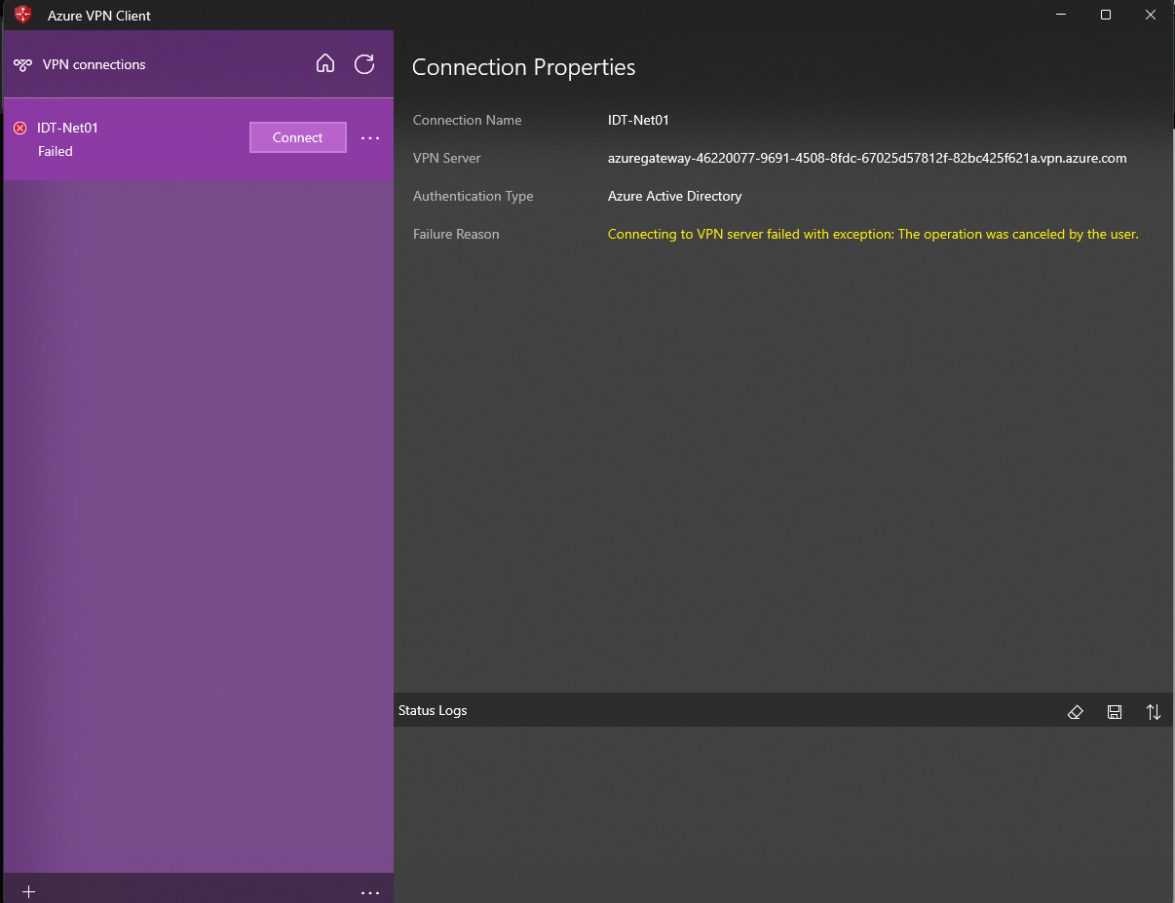
Azure Active Directory
05
01
03
06
02
04

Slide 12
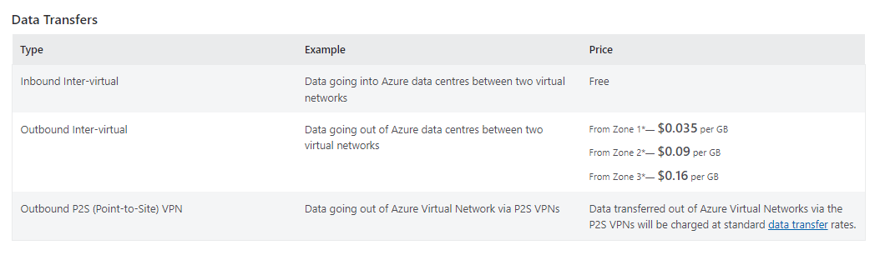
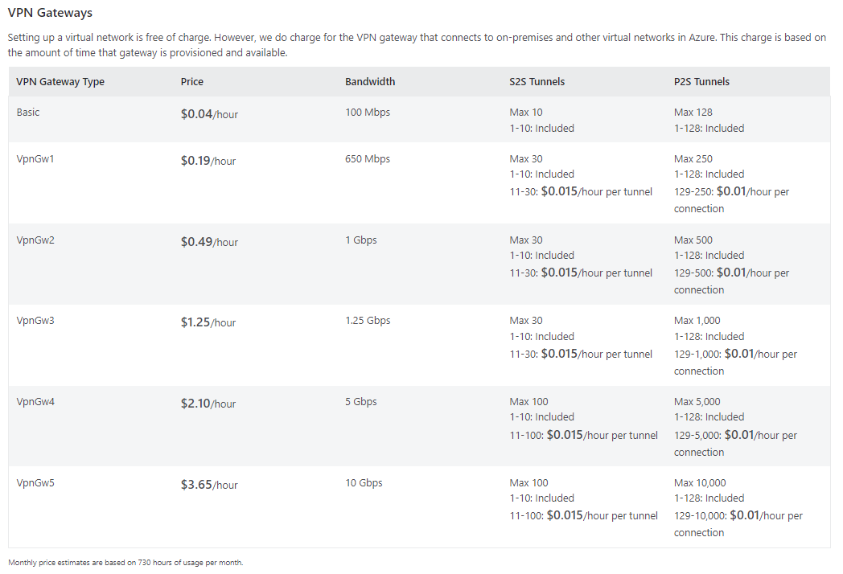
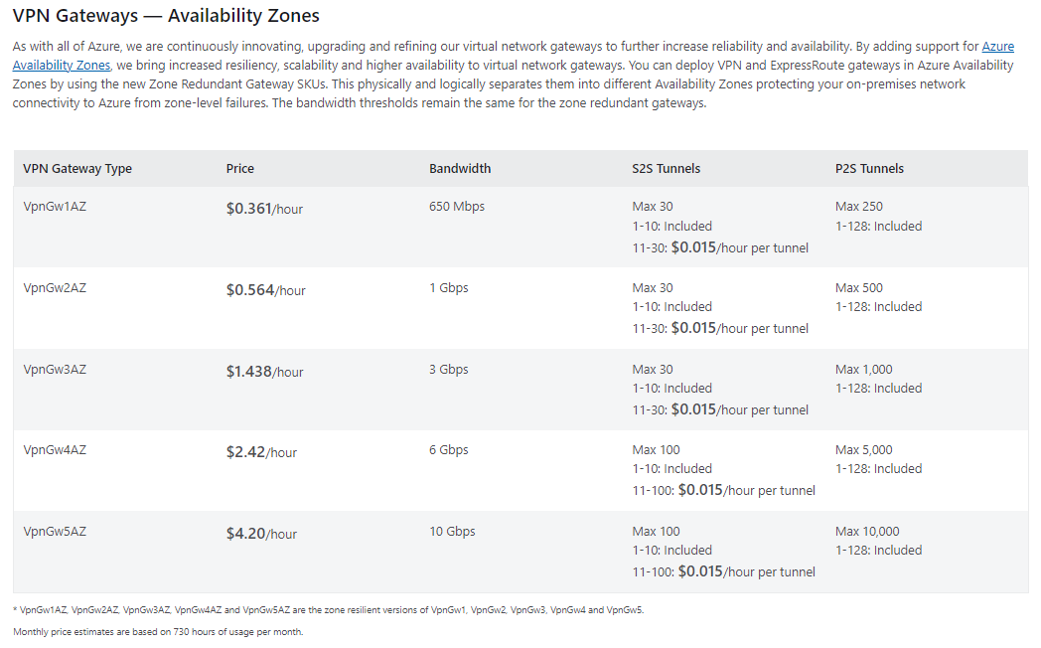
General Cost Structure for P2S Connection:
1. Type of VPN Gateway.
2. Availability Zone.
3. Data Transfer.

Slide 13
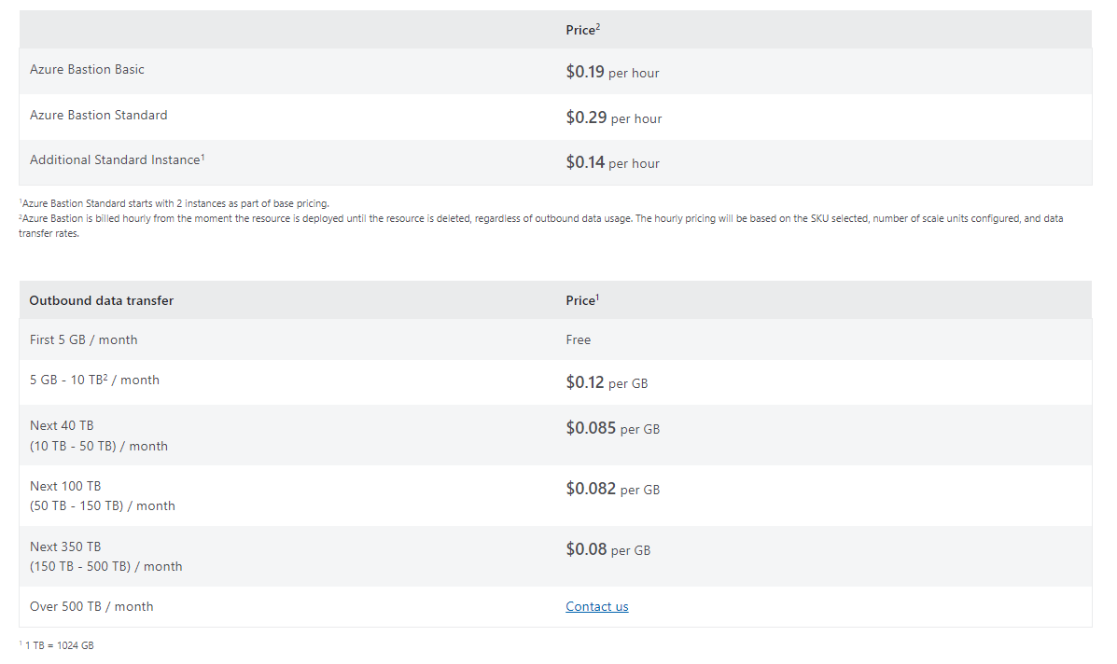
General Cost Structure for BASTION Connection:

Slide 14



Comparison:
 | Normal Vm | Bastion Hosted | P2S Gateway
Cost Saving
Easy to Access
Secured connectivity
AAD and MFA enabled
$212 - $514
$30- $140
Notes:
Virtual machine costing is excluded.

